Slide 1
How International Student Policy Changes Have Impacted NAIT's Enrolment Outlook

Slide 2
Outline
International Student Program (ISP) changes and timelines
Impacts on international applications
Short- and medium-term impacts on enrolment plan
How NAIT is responding and adapting

Slide 3
ISP changes announced in 2024/2025
January 2024
IRCC announced enrolment caps and Provincial Attestation Letters (PALs)
September 2024
Post-graduate Work Permit (PGWP) eligibility changes
Field of study requirement effective November 1, 2024
Tied to five high-demand sectors: agriculture, healthcare, STEM, trades, and transport
Bachelor’s, Master’s, Doctoral degrees from Universities are exempt
New English Language Proficiency test requirements announced
This is a significant change – 57% of NAIT programs are not PGWP eligible, accounting for 75% of our international enrolment.

Slide 4
ISP changes announced in 2024/2025
November 2024
Further reduction in international study permits targets by 10%
Graduate students now need PALs
Elimination of Student Direct Stream (SDS)
New study permit required when changing institutions
This is a significant change – SDS was a popular pathway for NAIT students, its elimination will likely lengthen study permit application processing times.
March 2025
Bachelor's and Master's degrees from Colleges and Polytechnics are now exempt
This is a minor change for NAIT – our Bachelor of Business Administration averages 30 new international students per year

Slide 5
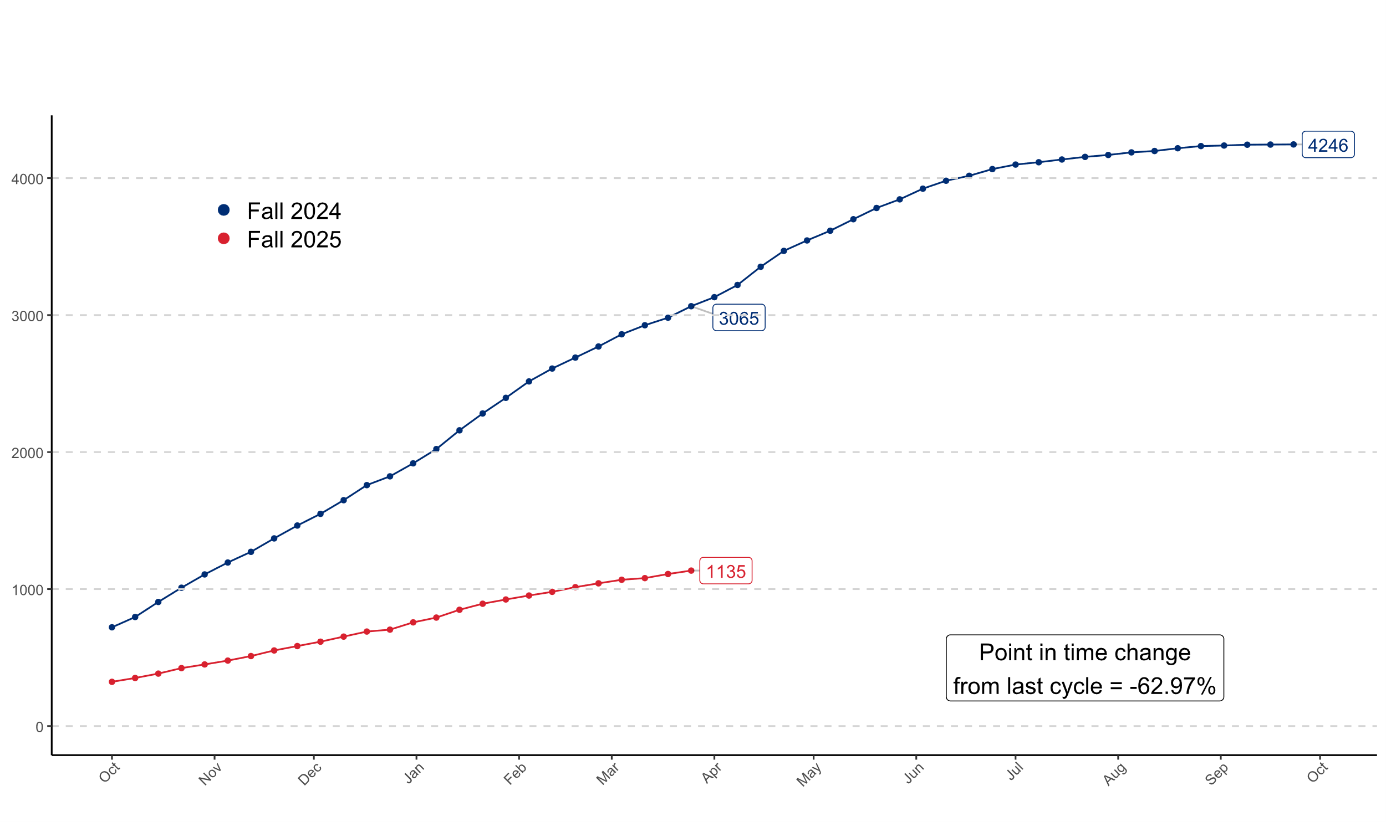
Ongoing Impacts for 2025
International Applications Received

Slide 6
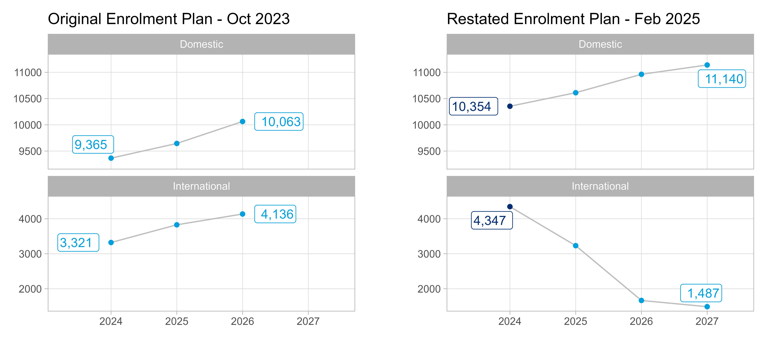
Projected Enrolments in Credit Programming Annual Full-Load Equivalents

Slide 7
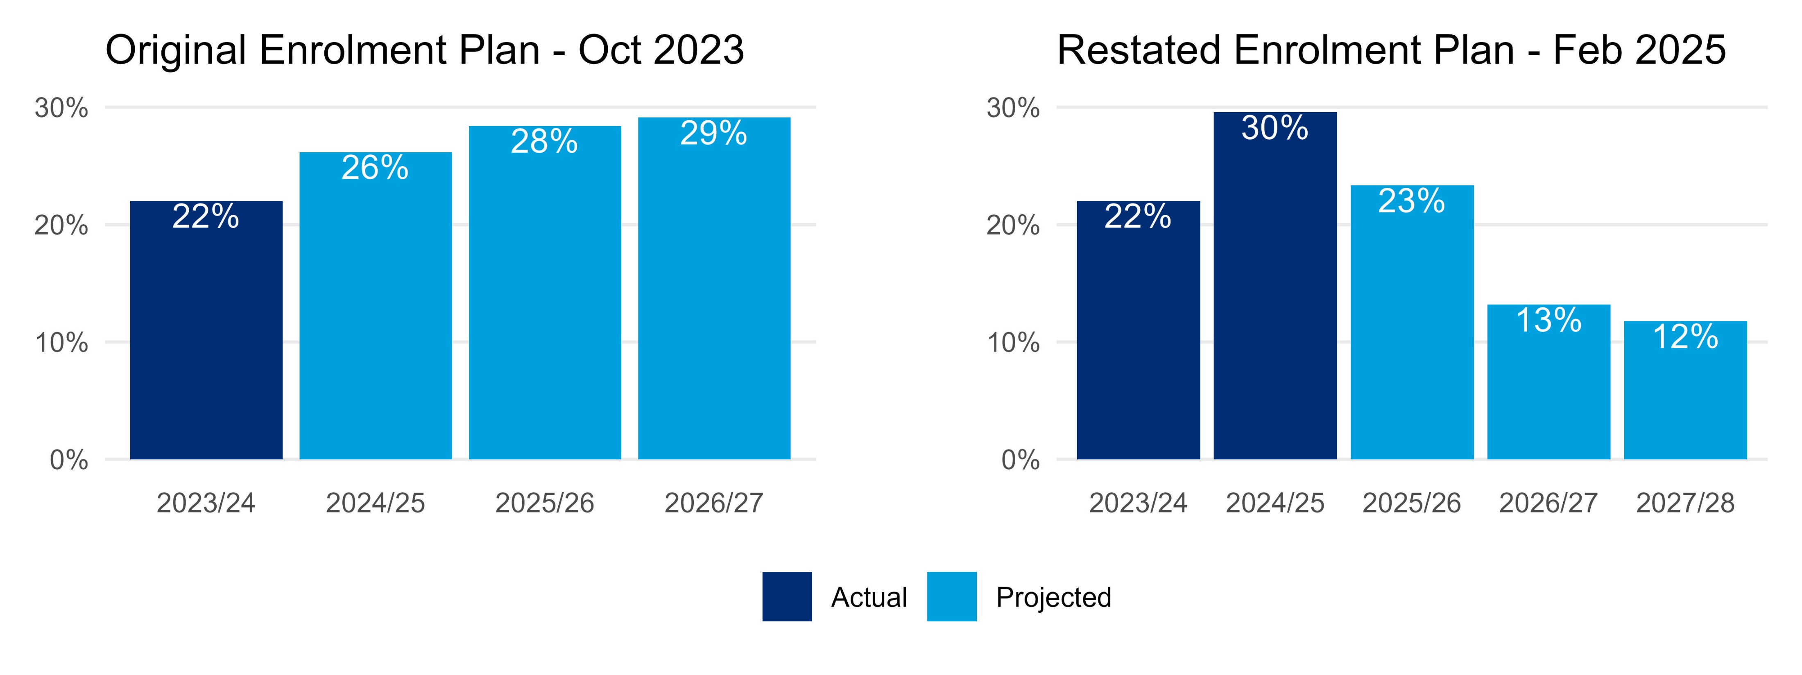
% International in Credit Programming

Slide 8
How is NAIT Responding?
Strengthening marketing and domestic recruitment
Refining international recruitment
Enhancing student retention
Improving operational efficiencies
Reviewing the viability and health of programs
Ongoing advocacy for PGWP eligibility of programs

Slide 9
Thank you

